Slide 1
College admission agent
CAPSTONE PROJECT
Presented By:
Student name : Karan Verma
College Name : Arya College of Engineering
Department : Artificial Intelligence and Data Science

Slide 2
OUTLINE
Problem Statement
Proposed System/Solution
Technology used
Wow factor
End users
Result
Conclusion
Future scope
References
IBM Certifications

Slide 3

Problem Statement
Navigating the college admissions process can be overwhelming for prospective students due to the complex eligibility criteria, varying deadlines, program-specific requirements, and institutional policies. Human advisors are often overburdened, and existing online resources are static, fragmented, or outdated. This results in confusion, missed opportunities, and inefficiencies for both applicants and institutions.
Problem
Applicants frequently struggle with:
Understanding program-specific eligibility and documentation requirements.
Keeping track of deadlines and submission guidelines.
Finding personalized, timely, and accurate answers to their questions.
Preparing and submitting required materials in a correct and complete manner.
Simultaneously, college admissions offices face:
High volumes of repetitive queries that could be automated.
Inconsistent advising quality due to human limitations or staff shortages.
Difficulty in offering 24/7 support and scalable communication.

Slide 4
Proposed Solution
An intelligent, agentic AI assistant purpose-built to support prospective college applicants throughout the admissions journey. The agent will serve as a responsive, policy-compliant, and domain-constrained digital advisor—capable of interacting with users in real time to provide accurate, timely, and personalized guidance on the admissions process.
Impact & Benefits :
For Students: Reduces stress, increases confidence, minimizes errors, and makes the admissions journey more accessible and navigable.
For Institutions: Lowers administrative load, increases engagement rates, and improves applicant quality through better-prepared submissions.

Slide 5
Technology used
Technology Used :
IBM cloud lite services
Natural Language Processing (NLP)
Retrieval Augmented Generation (RAG)
IBM Granite model
System Requirements:
Compatible with modern web browsers and devices.

Slide 6
IBM cloud services used
IBM Cloud Watsonx AI Studio
IBM Cloud Watsonx AI runtime
IBM Cloud Agent Lab
IBM Granite foundation model

Slide 7
Wow factors
24/7 Instant Support – No wait times, ever.
Hyper-Personalized Guidance – Tailored answers for each applicant.
Always Up-to-Date – Auto-syncs with real-time admission policies.
Smart Document Checking – Validates transcripts, SOPs, etc.
Strict Domain Focus – Refuses off-topic or risky questions.
Customizable for Any Institution – Easily adapted to any institution’s rules.
Multilingual – Supports global applicants in their native language.
Seamless Integration with Existing Systems – Easily connects to institutional portals, calendars, and document systems

Slide 8
End users
Students & Applicants
Adult Learners
Parents and Guardians
Educators
Third-Party EdTech Platforms

Slide 9
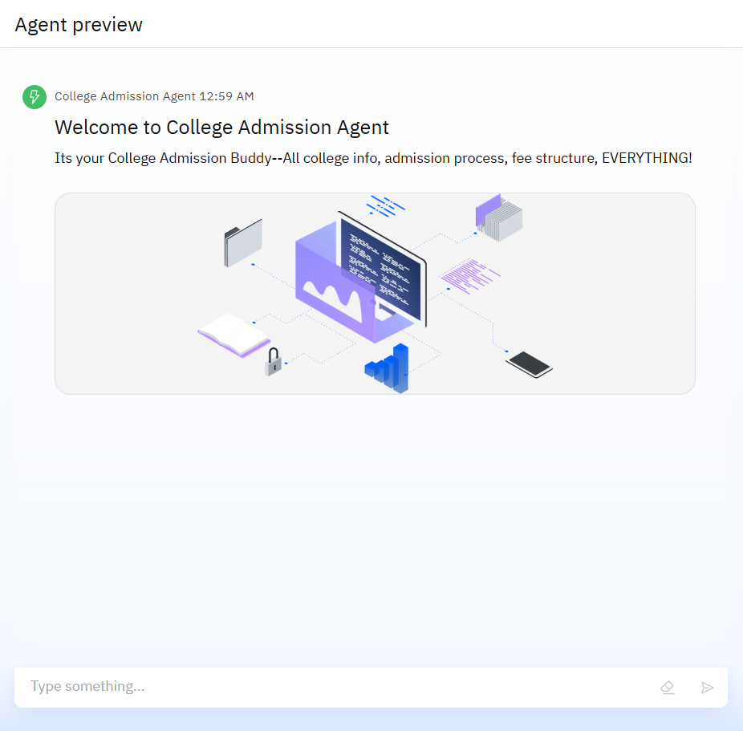
Result
Developed a college admission agent aimed at simplifying and enhancing the application process for prospective students.
Facilitates intuitive and efficient interaction through natural language processing capabilities.
Enhances user experience by providing timely and accurate information tailored to individual queries.

Slide 10
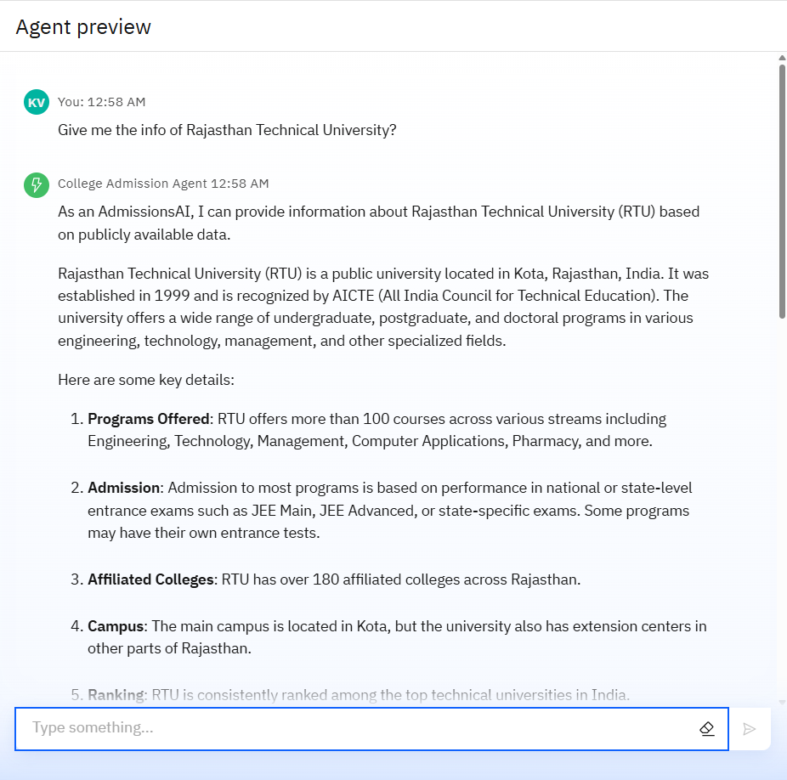
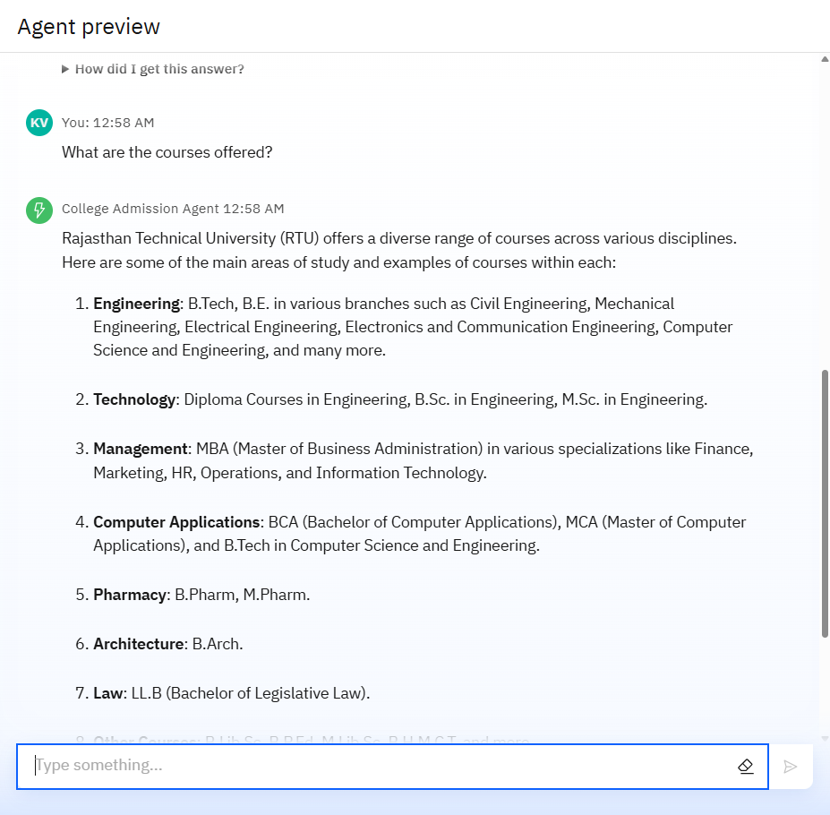
Result

Slide 11
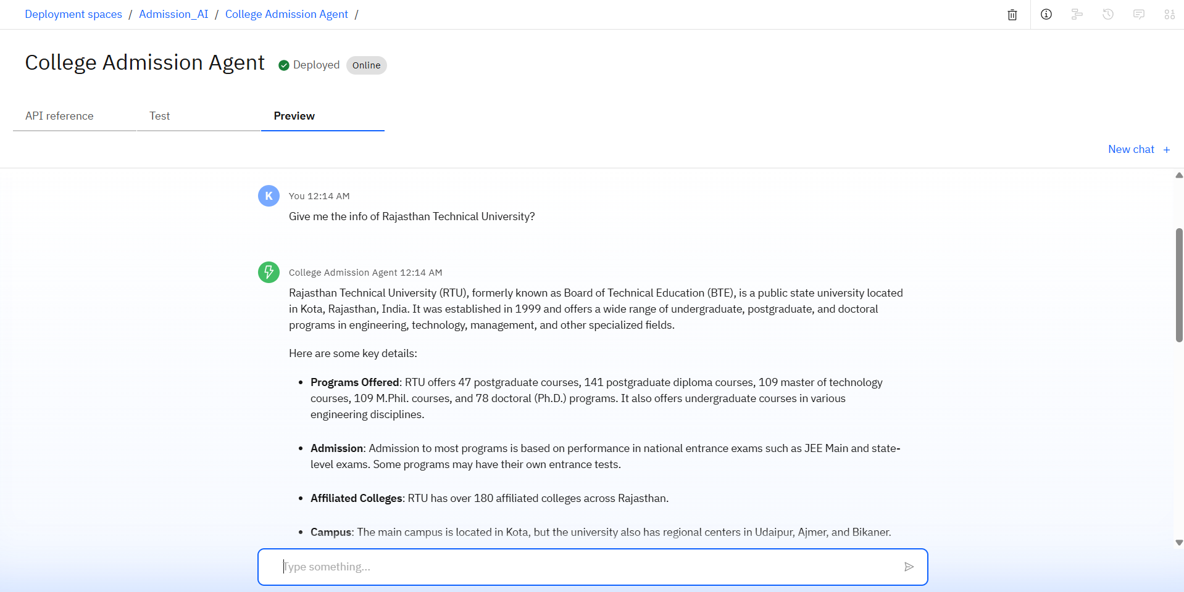
Result
After Deployment

Slide 12

Project Link
GitHub: https://github.com/Karanv777/College_Admission_Agent-Karan-Verma

Slide 13
Conclusion
The college admission agent represents a significant advancement in improving accessibility and user experience in the admission process.
By leveraging AI-powered natural language processing, it effectively addresses the informational needs of prospective students.
Offers a scalable solution to accommodate future enhancements and adapt to evolving user requirements.
Contributes to a streamlined and efficient admission process that benefits both applicants and the institution.

Slide 14
Future scope
Voice-Based Interaction: Enable voice assistants or phone-based support using natural language speech processing, making the agent even more accessible to students with limited digital literacy or disabilities.
Post-Admission Support: Extend the agent’s utility beyond admission—helping with onboarding, orientation schedules, housing, and course registration.
Personalized Assistance: Implement machine learning algorithms to offer personalized recommendations and adaptive guidance.
Multilingual Support: Integrate language translation capabilities to cater to diverse applicant demographics.
AI-Powered Essay and SOP Coaching: Provide students with structured feedback on their Statement of Purpose or admission essays, improving their quality while still encouraging original thinking.

Slide 15
References
IBM watsonx Assistant tutorial

Slide 16
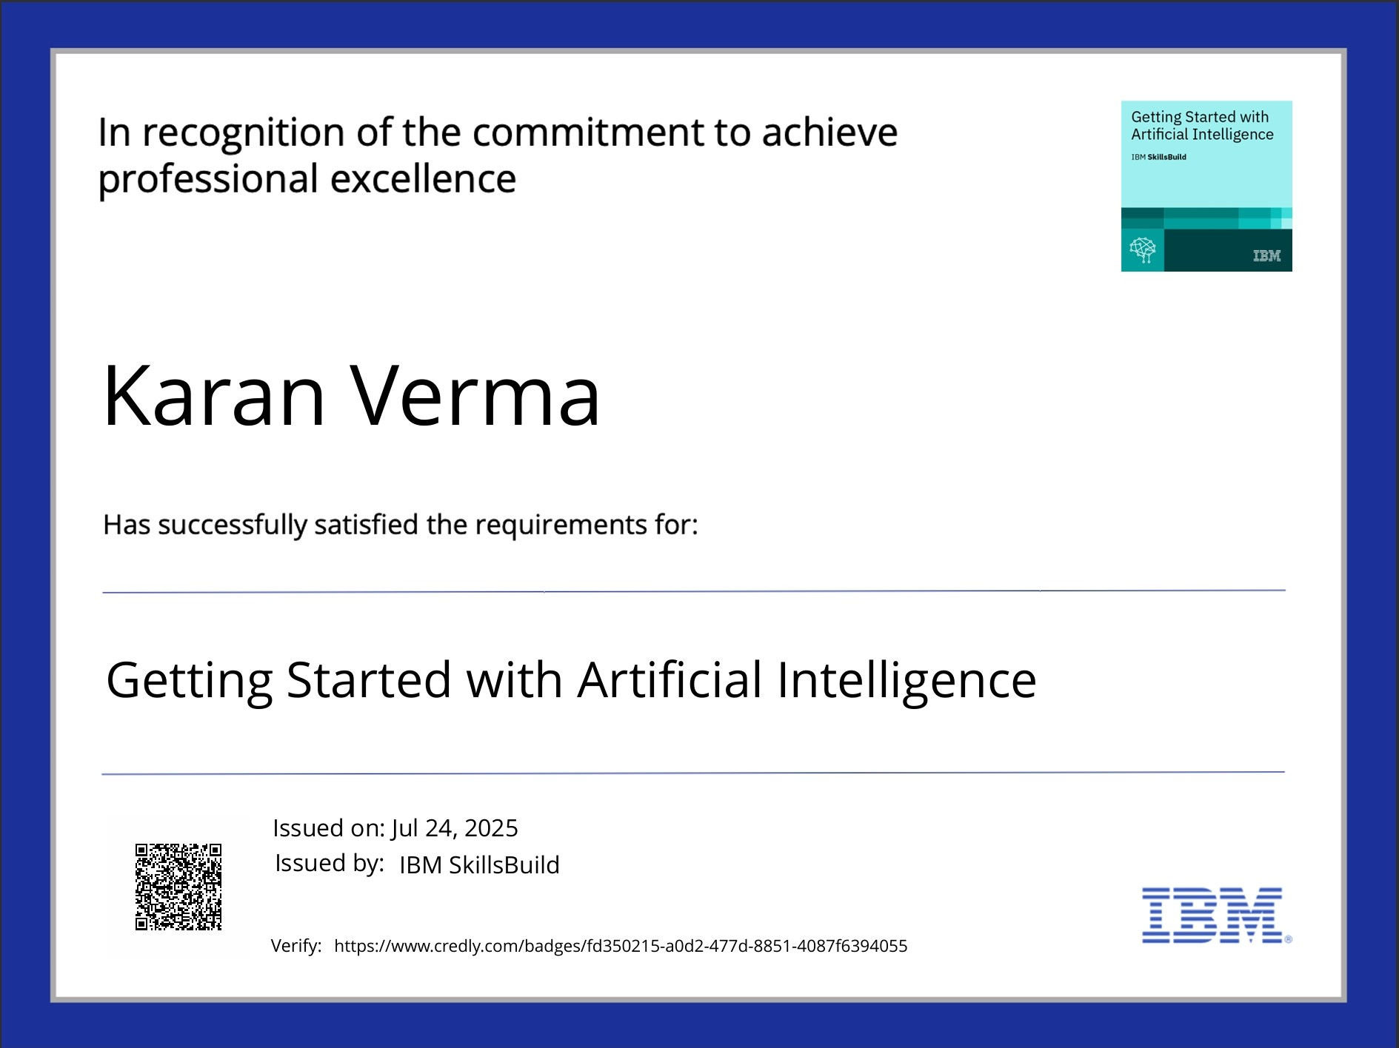
IBM Certifications

Slide 17
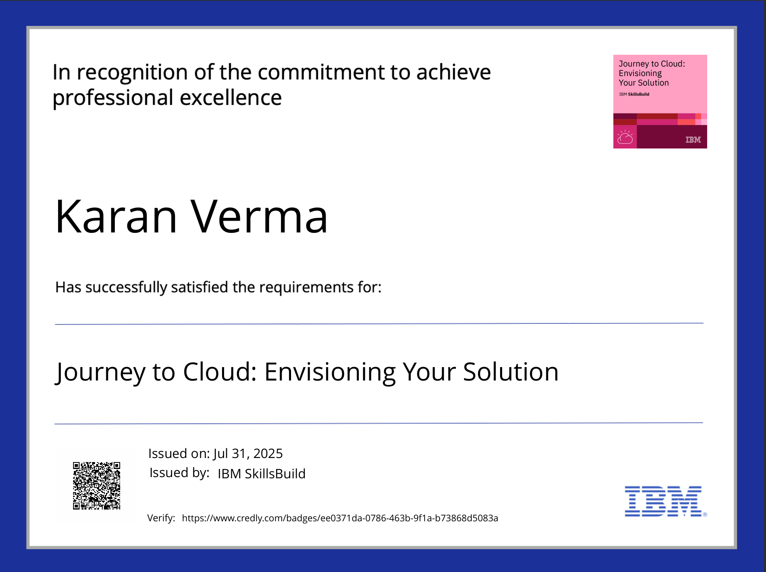
IBM Certifications

Slide 18
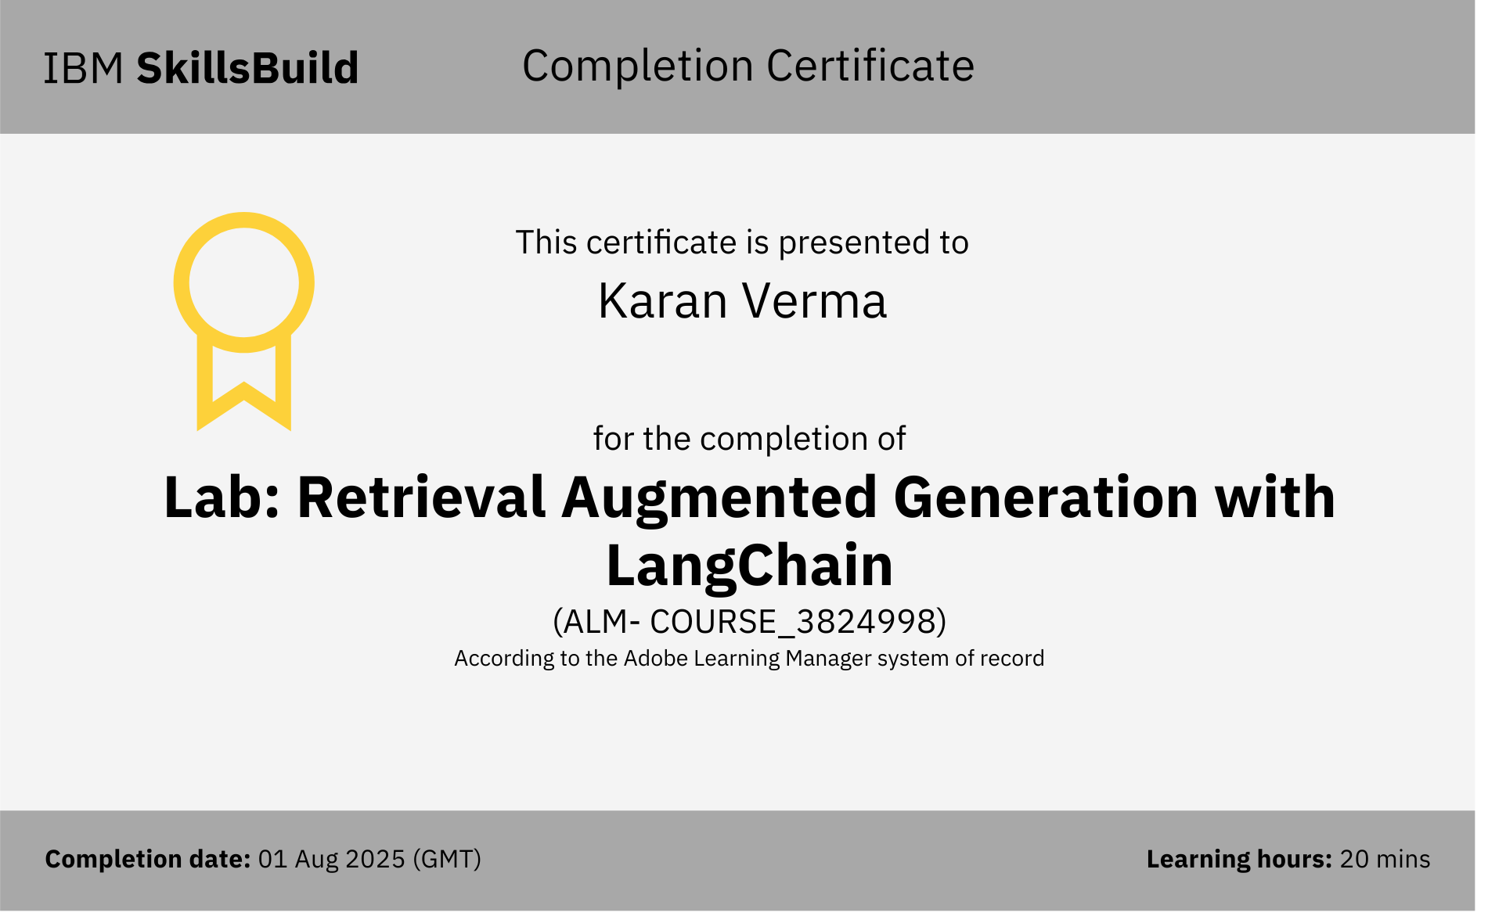
IBM Certifications

Slide 19
THANK YOU

